Slide 1

Chapter 1
Introduction

Slide 2
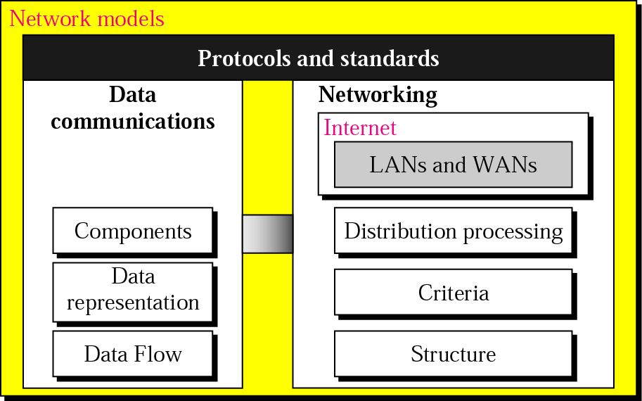
Data Communications and Networking

Slide 3
1.1 DATA COMMUNICATIONS
The term telecommunication means communication at a distance. The word data refers to information presented in whatever form is agreed upon by the parties creating and using the data. Data communications are the exchange of data between two devices via some form of transmission medium such as a wire cable.
Topics discussed in this section:
Components
Data Representation
Data Flow

Slide 4
Fundamental Characteristics
The effectiveness of a data communication system depends on three fundamental characteristics
  Delivery
    must deliver data to the correct destination
    (the intended device or user)
  Accuracy
    must deliver data accurately
  Timeliness
    must deliver data in a timely manner
  Jitter
    Refers to the variation in the packet arrival time.

Slide 5

Data communication system components
Figure 1.1 Five components of data communication

Slide 6
Data communication system components (cont’d)
Message
  is the information(data) to be communicated.
  (text, numbers, pictures, sound, video or any combination of these)
Sender
  is the device that sends the data message.
  (computer, workstation, telephone handset, video camera)
Receiver
  is the device that receives the message.
  (computer, workstation, telephone handset, video camera)

Slide 7
Data communication system components (cont’d)
Medium
  is the physically path by which a message travels from sender to receiver.
  (twisted pair wire, coaxial cable, fiber- optic cable, laser , or radio waves(terrestrial or satellite microwave))
Protocol
  is a set of rules that govern data communication.

Slide 8
Data Presentation
Text is represented as a bit pattern.
  Code : Each sets of bit patterns to represent text symbols.
  ASCII : by ANSI, 7bits
  Extended ASCII, 8bits
  Unicode : 16 bits
  ISO : 32bits
Numbers : also represented by bit patterns.
Images : also represented by bit patterns. (Picture)
Audio : It is continuous, not discrete. (Voice or music)
Video : The recording or broadcasting of a picture or movie.

Slide 9
Direction of Data Flow
is used to define the direction of signal flow between two link devices
Simplex
  unidirectional, as on a one-way street (keyboard, monitor)
Half-Duplex
  each station can both transmit and receive, but not at the same time
Full-Duplex
  both stations can transmit and receive simultaneously

Slide 10

Direction of Data Flow (cont’d)
Figure 1.2 Data flow (simplex, half-duplex, and full-duplex)

Slide 11
1.2 NETWORKS
A network is a set of devices (often referred to as nodes) connected by communication links. A node can be a computer, printer, or any other device capable of sending and/or receiving data generated by other nodes on the network.
Topics discussed in this section:
Distributed Processing
Network Criteria
Physical Structures
Network Models
Categories of Networks
Interconnection of Networks: Internetwork

Slide 12
Distributed processing
A task is divided among multiple computers.
Instead of one single large machine being responsible for all aspects of a process, separate computers handle a subset.

Slide 13
Network Criteria
Network Criteria
Performance
Reliability
Security

Slide 14
Performance
Depends on a number of factors.
  number of users
  type of transmission medium(data rate)
  hardware
  software : error-free delivery
Evaluated by two networking metrics:
  Throughput and Delay.

Slide 15
Reliability
Frequency of failure
Recovery time of a network after a failure
Catastrophe
  Networks must be protected from catastrophic events such as fire, earthquake, or theft.

Slide 16
Security
Protecting data from Unauthorized access
Protecting data from Viruses and Worms

Slide 17
Physical Structures
Type of Network Connection
  Point-to-point
    provides a dedicated link between two devices.
  Multipoint : multi-drop
    is configuration in which more than two specific devices share a single link

Slide 18

Physical Structures (cont’d)
Figure 1.3 Types of connections: point-to-point and multipoint

Slide 19

Physical Topology

Slide 20
Physical Topology
Mesh
  Every device has a dedicated point-to-point link to every other device.
  A fully connected mesh network therefore has
  n(n-1)/2 physical channels to link n devices.

Slide 21

Mesh
Mesh

Slide 22
Mesh (cont’d)
Advantages
  The use of dedicated links guarantees that each connection can carry its data load.
  Mesh topology is robust.
  Privacy and security.
  Point-to-point links make fault identification and fault isolation easy.

Slide 23

Mesh (cont’d)
Disadvantages
  are related to the amount of cabling and the number of I/O ports
  because every device must be connected to every other device, installation and reconfiguration are difficult
  the sheer bulk of the wiring can be greater than the available space(in walls, ceiling, or floors) can accommodate
  the hardware required to connect each link (I/O port and cable) can be prohibitively expensive

Slide 24

Star Topology
Each device has a dedicated point-to-point link only to a central controller, usually called a hub
Star Topology

Slide 25
Star (cont’d)
Advantage
  Each device needs only one link and one I/O port to connect it to any number of others (easy to install and reconfigure)
  Robustness
    if one link fails, only that link is affected

Slide 26
Tree Topology
Tree topology is a variation of a star
  active hub(central hub)
    contains a repeater, which is a hardware device that generates the received bit patterns before sending them out
  passive hub
    provides a simple physical connection between the attached devices

Slide 27
Bus Topology
Bus topology is multipoint. One long cable acts as a backbone to link all the devices in the network
Nodes are connected to the bus cable by drop lines and taps
  Drop line
    is a connection running between the device and the main cable
  Tap
    is a connector either splices into the main cable or punctures the sheathing of a cable to create a contact with the metallic core

Slide 28

Bus Topology (cont’d)

Slide 29
Bus (cont’d)
Advantages
  include ease of installation
Disadvantages
  include difficult reconfiguration and fault isolation

Slide 30

Ring Topology
Each device has a dedicated point-to-point line configuration only with the two devices on either side of it
Advantage
  is relatively easy to install and reconfigure
  fault isolation is simplified
Disadvantage
  unidirectional traffic
    break in the ring can disable the entire network
      --> needs dual ring

Slide 31

Hybrid Topology
A network can be hybrid.
For example, a main star topology with each branch connecting several stations in a bus topology.

Slide 32
Categories of Networks
Three primary categories
  size, ownership, distance it cover, physical architecture
Network
Local area networks
(LAN)
Metropolitan area network
(MAN)
Wide area network
(WAN)

Slide 33

LAN (Local Area Networks)
LAN is usually privately owned and links the devices in a single office, building or campus
Figure 1.10 An isolated LAN connecting 12 computers to a hub in a closet

Slide 34
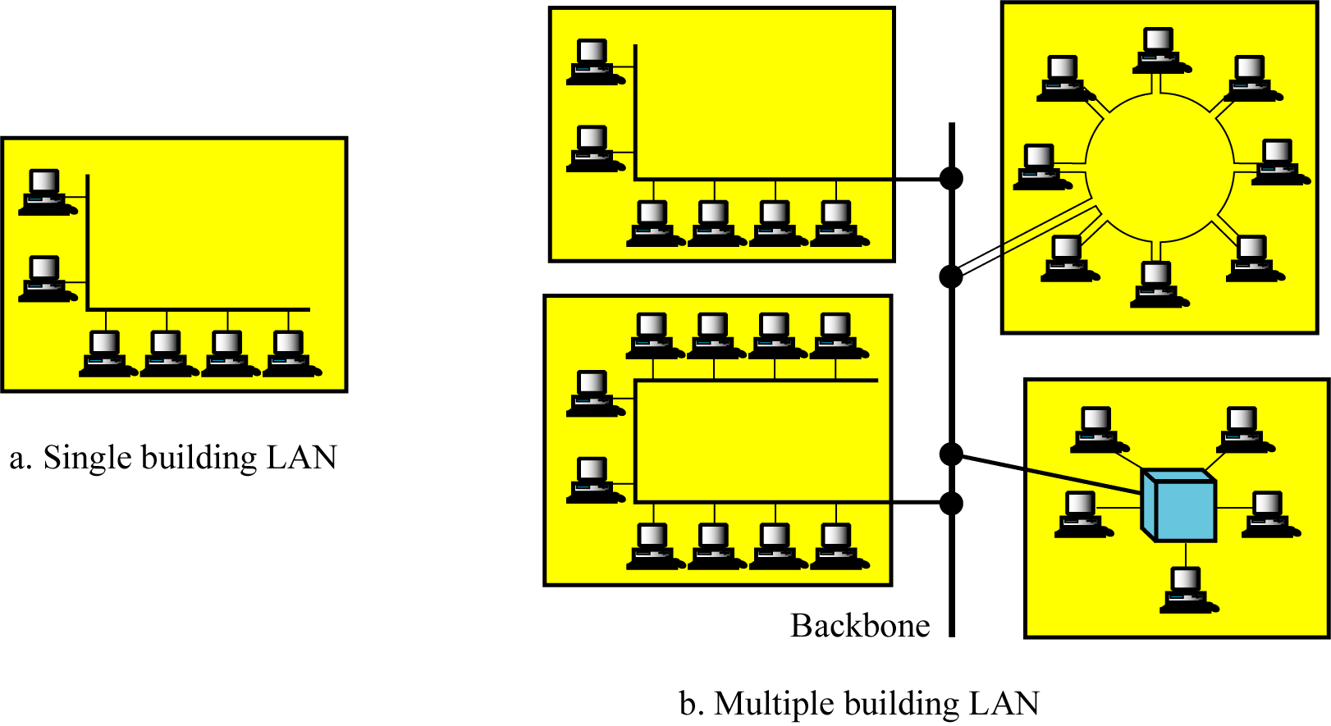
Categories of Networks (cont’d)

Slide 35
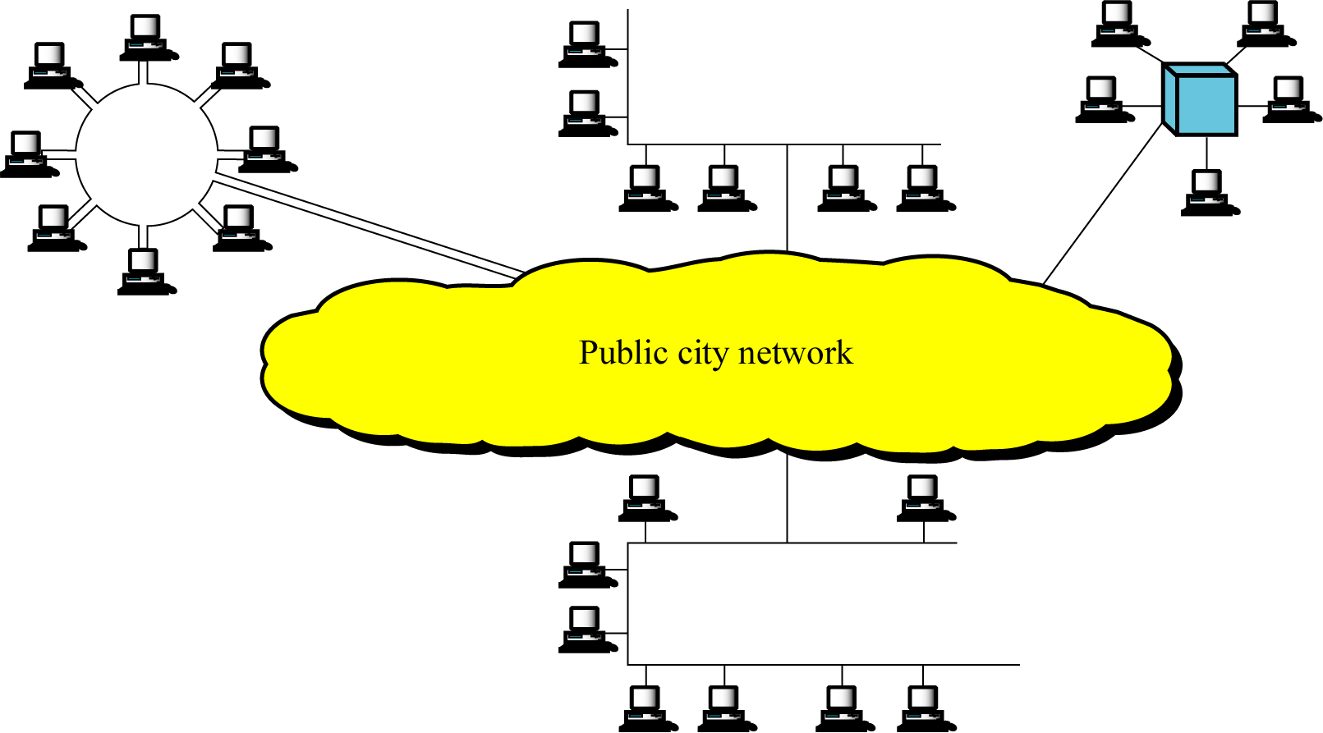
Categories of Networks (cont’d)
MAN (Metropolitan Area Networks)
  is designed to extend over an entire city

Slide 36
Categories of Networks (cont’d)
WAN(Wide Area networks)
  provides long-distance transmission of data, voice, image, and video information over large geographical areas that may comprise a country, a continent, or even the whole world

Slide 37

Categories of Networks (cont’d)
Figure 1.11 WANs: a switched WAN and a point-to-point WAN

Slide 38

Interconnection of Networks : Internetwork
Two or more networks are connected, they become an internet.
Figure 1.12 A heterogeneous network made of four WANs and two LANs

Slide 39
1.3 THE INTERNET
The Internet has revolutionized many aspects of our daily lives. It has affected the way we do business as well as the way we spend our leisure time. The Internet is a communication system that has brought a wealth of information to our fingertips and organized it for our use.
Topics discussed in this section:
A Brief History
The Internet Today (ISPs)

Slide 40
Internet
A Brief History
  Internet (not internet)
  ARPANET (Advanced Research Projects Agency: ARPA) – mid-1960s
    Advanced Research Projects Agency (ARPA) in the DOD : presented ideas of ARPANET, 1967
    Reality : 1969 (UCLA, UCSB, SRI, U of Utah)
  Birth of Internet : in 1972
    Vint Cerf and Bob Kahn : Internetting Project
  TCP/IP : A paper by Cerf and Kahn in 1973
    In 1983, TCP/IP became to official protocol for the ARPANET
  MILNET : in 1983
  CSNET, NSFNET, ANSNET, …

Slide 41
Internet Today
1969. Four-node ARPANET established.
1970. ARPA hosts implement NCP.
1973. Development of TCP/IP suite begins.
1977. An internet tested using TCP/IP.
1978. UNIX distributed to academic sites.
1983. TCP/IP becomes the official protocol
1983. MILNET was born.
1986. NSFNET established.
1986, IETF First Meeting
1990. ARPANET replaced by NSFNET.
1991. WWW by CERN
1995. NSFNET became a research network.
1995. ISPs started.
2006 GENI (Global Environment for Network Innovations) for Future Internet

Slide 42

Internet Today
Figure 1.13 Hierarchical organization of the Internet

Slide 43
1-4 PROTOCOLS AND STANDARDS
In this section, we define two widely used terms: protocols and standards. First, we define protocol, which is synonymous with rule. Then we discuss standards, which are agreed-upon rules.
Topics discussed in this section:
Protocols
Standards
Standards Organizations
Internet Standards

Slide 44
Protocols and Standard
Communication in computer networks
  Communication occurs between entities in different systems
Entity
  is anything capable of sending or receiving information
Protocol
  is a set of rules that govern data communication

Slide 45
Protocol & Standards (cont’d)
Key elements of a Protocol
  Syntax (문법)
    refers to the structure or format of the data, meaning the order in which they are presented.
  Semantics (의미론)
    refers to the meaning of each section of bits.
  Timing (타이밍)
    refers to two characteristics (when data should be sent and how fast it can be sent)

Slide 46
Standards
Standards(표준)
  are essential in creating and maintaining an open and competitive market for equipment manufactures and in guaranteeing national and international interoperability of data and communications technology and processes.
Standards
De facto
(by fact)
De jure
(by law)

Slide 47
Standards Organizations (표준화 기구)
Standard Creation Committees
  ISO (The International Standard Organization)
    created in 1947
    Multi national body
    is an organization dedicated to worldwide agreement on international standards in a variety of fields (scientific, technological, economic activity)

Slide 48
Standards Organizations (cont’d)
  ITU-T(International Telecommunications Union - Telecommunications Standards Sector)
    is an international standards organization related to the United Nations that develops standards for telecommunications.
    Two popular standards developed by ITU-T are the V series (data transmission over phone lines) and the X series (transmission over public digital networks)

Slide 49
Standards Organizations (cont’d)
  ANSI (American National Standard Institute)
    is a nonprofit organization and is the U.S. voting representative to be both the ISO and the ITU-T
  IEEE (Institute of Electrical and Electronic Engineers)
    is the largest national professional group involved in developing standards for computing, communication, electrical engineering, and electronics)
  EIA (Electronic Industries Association)
    is an association of electronics manufactures in the United States. (EIA-232-D, EIA-530 standards)

Slide 50
Standards Organizations (cont’d)
Forums
  consist of representatives from corporation that test, evaluate and standardize new technologies.
  Frame Relay Forum
  ATM Forum and ATM consortium
Regulatory agencies
  FCC (Federal Communications Commission)

Slide 51
Internet Standards
Internet standard by IETF (Internet Engineering Task Force)
  is a thoroughly tested specification that is useful to and adhered by those who work with the Internet
A specification begins as an Internet draft
  Working document with no official status and six-month life-time
RFC (Request for Comment) Recommendation from Internet authorities

Slide 52
Standards (cont’d)
by law standard
  ~ are those that have been legislated by an officially recognized body.
by fact standard
  ~ are often established originally by manufactures seeking to define the functionality of a new product or technology.
  proprietary (closed)
    ~ are those originally invented by a commercial organization as a basis for the operation of its products.
  nonproprietary (open)
    ~ are those originally developed by group or committees that have passed them into the public domain.

Slide 53
Standards Organizations (cont’d)
Telecommunications Technology Association 한국정보통신기술협회(TTA) : http://www.tta.or.kr
  ITU related standardization
Korean Agency for Technology and Standards 한국기술표준원[KATS] : http://www.kats.go.kr
  ISO related standardization

Slide 54
Summary (1)
Data communications are the transfer of data from one device to another via some form of transmission medium.
A data communications system must transmit data to the correct destination in an accurate and timely manner.
The five components that make up a data communications system are the message, sender, receiver, medium, and protocol.
Text, numbers, images, audio, and video are different forms of information.
Data flow between two devices can occur in one of three ways: simplex, half-duplex, or full-duplex.
A network is a set of communication devices connected by media links.
In a point-to-point connection, two and only two devices are connected by a dedicated link. In a multipoint connection, three or more devices share a link.

Slide 55
Summary (2)
Topology refers to the physical or logical arrangement of a network. Devices may be arranged in a mesh, star, bus, or ring topology.
A network can be categorized as a local area network or a wide area network.
A LAN is a data communication system within a building, plant, or campus, or between nearby buildings.
A WAN is a data communication system spanning state, countries, or the whole world.
An internet is a network of networks.
The Internet is a collection of many separate networks.
There are local, regional, national, and international Internet service providers.

Slide 56
Summary (3)
A protocol is a set of rules that govern data communication; the key elements of a protocol are syntax, semantics, and timing.
Standards are necessary to ensure that products from different manufacturers can work together as expected.
The ISO, ITU-T, ANSI, IEEE, and EIA are some of the organizations involved in standards creation.
Forums are special-interest groups that quickly evaluate and standardize new technologies.
A Request for Comment (RFC) is an idea or concept that is a precursor to an Internet standard.

Slide 57

Q & A

